Slide 1
Transforming steering controls to self driving
Week 7 report
Hongshuo Wang
Professor Siu Ling Leung

Slide 2
Train SSD mobilenetv2 and Visualize on Jetbot

Slide 3
Next (More training and collecting more data)
Need 200 pages per class more data
Run at least 2000000 steps
In order to make loss below 0.5%

Slide 4
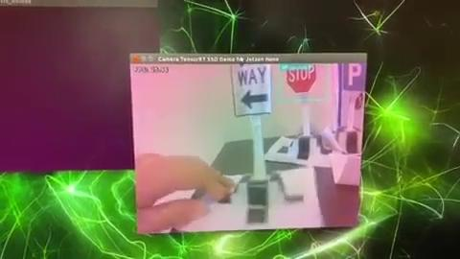
Demo

